Slide 1
Geostatistics
Getting started with R
Ir. Milkias SEMEREAB

Slide 2
Lecture Outline
A brief introduction to R programing language
R and Rstudio Installation
R Operators
R basic data types
R data structures
Functions
Slight touch to packages
Representing data in useful manner
Hands on R
Geostatistics

Slide 3

What is R ?
R is a language and environment for statistical computing and graphics, is similar to the S language and environment.
R provides a wide variety of statistical (linear and nonlinear modelling, classical statistical tests, time-series analysis, classification, clustering, …) and graphical techniques, and is highly extensible.
Well-designed publication-quality plots can be produced, including mathematical symbols and formulae
R is available as a Free Software
Software and object-oriented language
Geostatistics

Slide 4
Why R is interesting for us?
R is an interpreted language, not a compiled one, meaning that all commands typed on the keyboard are directly executed without requiring to build a complete program like in most computer languages (C, Fortran, Java, ).
RStudio playing role in popularity of R.
R is high level language.
R's syntax is very simple and intuitive.
R manual/Documentation
R packages. E.g., R+gstat as the only complete and fully-operational package for geostatistical computing.
Very active R community
Stackoverflow
R-bloggers etc.
Geostatistics

Slide 5
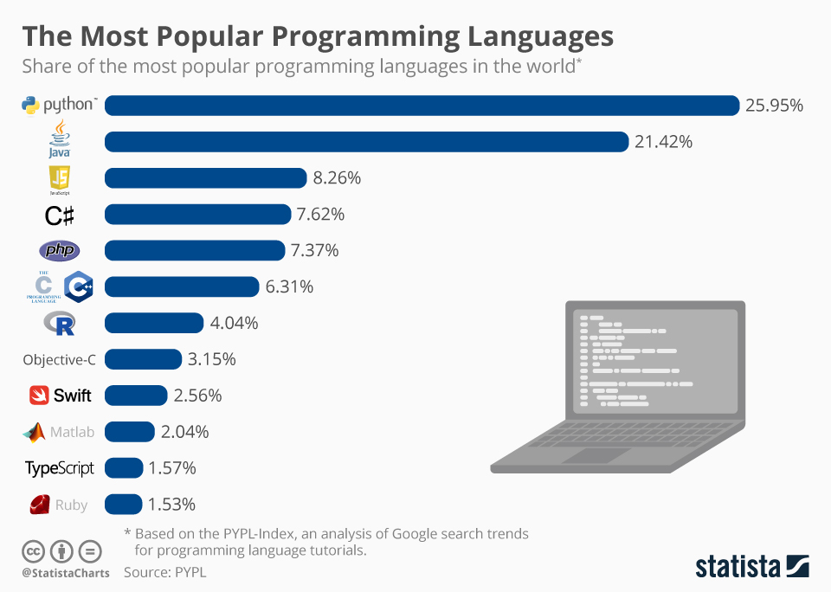
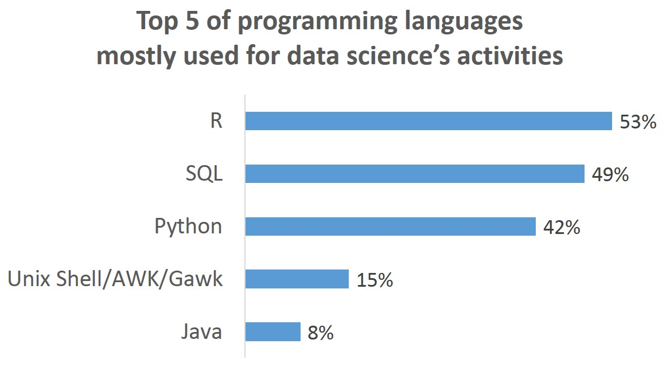
Popularity of R
https://www.statista.com/chart/16567/popular-programming-languages/
Geostatistics
https://www.datasciencecentral.com/top-programming-languages-for-data-science-first-partial-survey/

Slide 6
R and Rstudio
Download the version of R appropriate for your computer
https://cran.r-project.org/
RStudio is a set of integrated tools designed to help you be more productive with R. It includes;
A console
Syntax-highlighting editor that supports direct code execution
Variety of robust tools for plotting, viewing history, debugging and managing your workspace.
Download R Studio Desktop
https://rstudio.com/products/rstudio/download/
Geostatistics

Slide 7
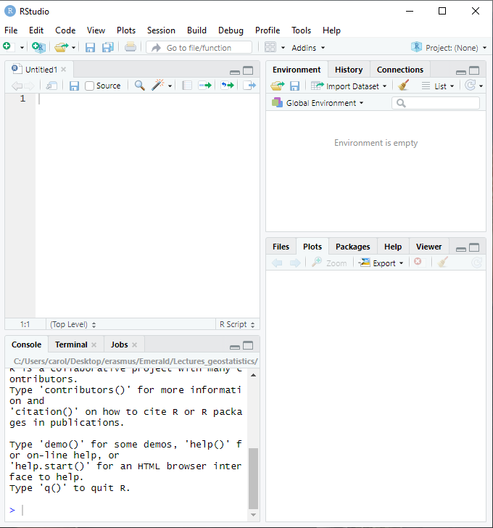
Rstudio Windows
3. Workspace &
History
1. Code Editor
(script window)
4. Plots, packages &
Files window
2. R Console

Slide 8
R as calculator
>6*6
[1] 36
>6/3
[1] 2
sqrt (100)
[1] 10
>(3+5)*(6-7)/(6*6+7)
>sqrt(9)
>4^2
>log(2)
>exp(6)
Geostatistics

Slide 9
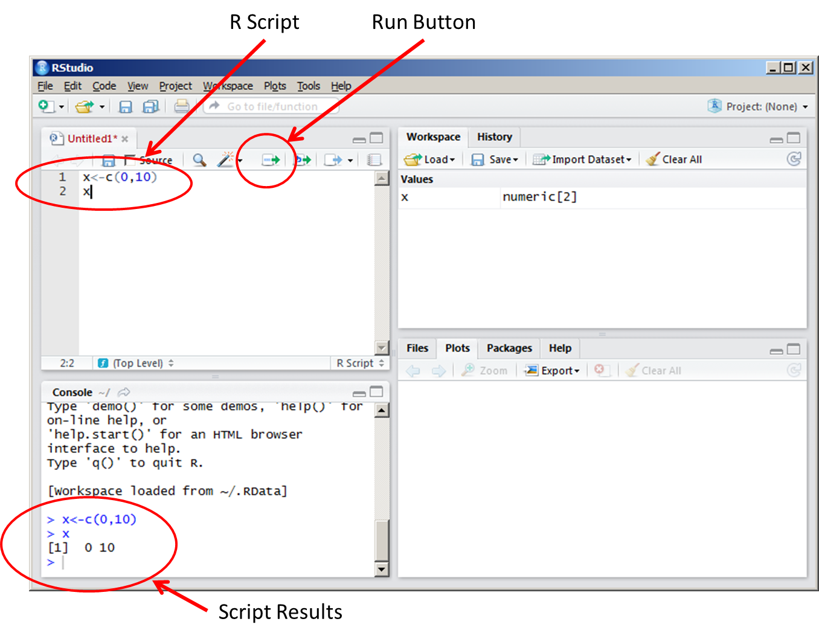
Rstudio Windows: Running code in script vs console.
When running the code directly in the console, it isn't saved for being reproduced further. If we need (and we usually do) to write a reproducible code to solve a specific task, we have to write and save it in a script file rather than in the console.

Slide 10
Variable Assignment
We assign values to variables with the assignment operator "=". We should note that another form of assignment operator "<-" is also in use.
Note: Variable assignment is not same as equality !
> x = 5
> x
[1] 5
> y <- 7
> y
[1] 7

Slide 11
Basic Data types in R
Numeric
Integer
Logical
Character
Complex

Slide 12
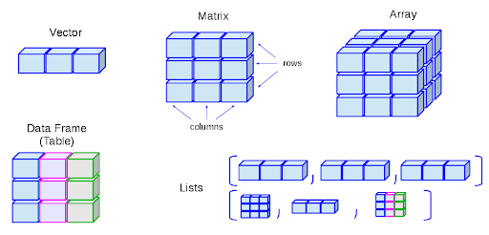
From R data type to R Data structures
Geostatistics
Notes:
“plot3D” - Draws a 3D scatterplot, visualising 2-D and 3-D data.
“fields” - For curve, surface and function fitting with emphasis on spatial data, geostatistics and spatial statistics.
“lattice” - Improve the graphics by providing better defaults and the ability to easily display multivariate relationships
“corrplot” - graphical display of a correlation matrix

Slide 13
From R data type to R Data structures
Geostatistics
Notes:
“plot3D” - Draws a 3D scatterplot, visualising 2-D and 3-D data.
“fields” - For curve, surface and function fitting with emphasis on spatial data, geostatistics and spatial statistics.
“lattice” - Improve the graphics by providing better defaults and the ability to easily display multivariate relationships
“corrplot” - graphical display of a correlation matrix

Slide 14
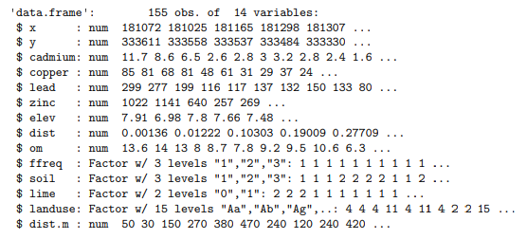
Data frame structure
Geostatistics
Variables
Variables records
Notes:
“plot3D” - Draws a 3D scatterplot, visualising 2-D and 3-D data.
“fields” - For curve, surface and function fitting with emphasis on spatial data, geostatistics and spatial statistics.
“lattice” - Improve the graphics by providing better defaults and the ability to easily display multivariate relationships
“corrplot” - graphical display of a correlation matrix

Slide 15
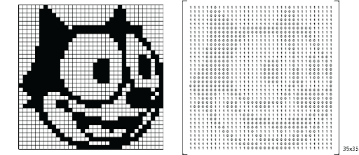
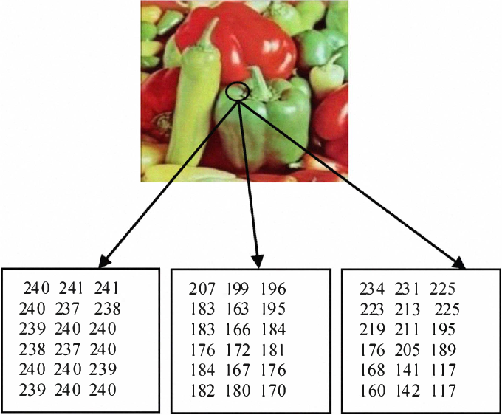
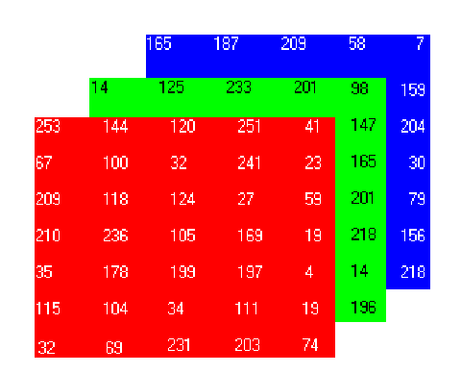
Data structures in R
?
Geostatistics
Notes:
“plot3D” - Draws a 3D scatterplot, visualising 2-D and 3-D data.
“fields” - For curve, surface and function fitting with emphasis on spatial data, geostatistics and spatial statistics.
“lattice” - Improve the graphics by providing better defaults and the ability to easily display multivariate relationships
“corrplot” - graphical display of a correlation matrix

Slide 17
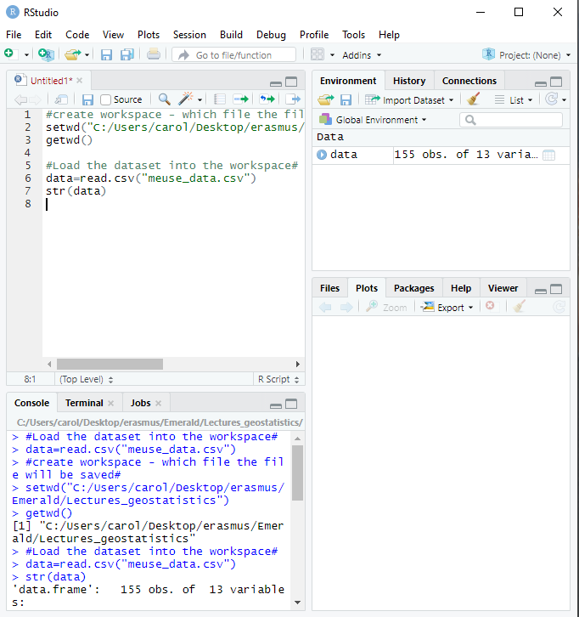
First steps in new project
Create your working directory:
setwd(“”)
Show your working directory:
getwd()
Lead the dataset into the working space:
data=read.csv(“meuse_data.csv”)
Shortcut for save my workspace:
save.image("data.RData")
Geostatistics

Slide 18
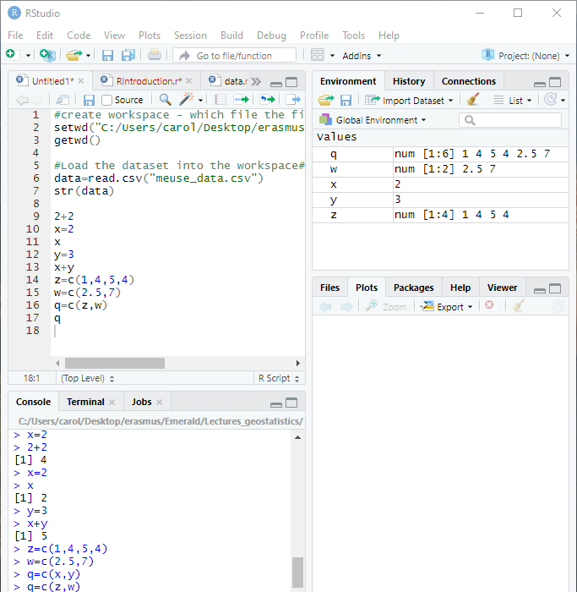
Vector creation
x=c(1,4,5,4)
>x
X[1] #first value of the vector
>y=c(2,5,7)
>y
>z=c(x,y)
>z
>max(), min(),
length(), sum(),
median()
Geostatistics

Slide 19
Condition
Commands if and else allow you to perform a conditional operation.
>x=4
>if(x>2){print("ok")} # why “” ?
>if(x<2){print("ok")}
>if(x<2){print("ok")}else{print("non")}
>if(T){print("Obviously!")}
- Example: if function for indicating for metal low, medium, high and super high grades…
Geostatistics

Slide 20
Loops
Loops allow you to repeat an operation.
>for(i in 1:10){print(i)}
>for(i in 1:10){print(2*i)}
>for(i in 10:1){print(i)}
>x=rep(0,10)
>for(i in 1:10){x[i]=i}
>x
Geostatistics

Slide 21
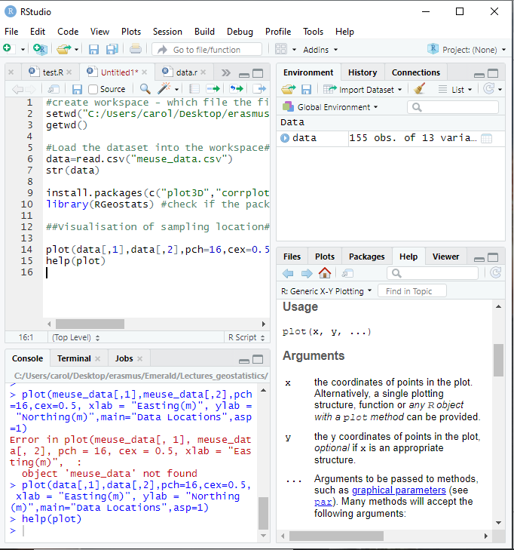
Other usefull functions
? Or help() – to know what the function is used for
Geostatistics

Slide 22
Other usefull functions
Assignment operator: = or <-
Comment #
Geostatistics

Slide 23
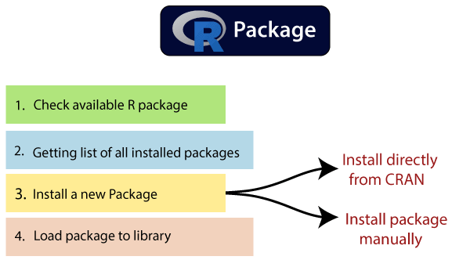
Statistics- Packages
Geostatistics
Base packages (CRAN) : plot3D, corrplot, lattice...
Contributed packages (Github, purpose specific sources): RGeostats # Note: Installing Rtools is required prior to installing contributed packages to R
Notes:
“plot3D” - Draws a 3D scatterplot, visualising 2-D and 3-D data.
“fields” - For curve, surface and function fitting with emphasis on spatial data, geostatistics and spatial statistics.
“lattice” - Improve the graphics by providing better defaults and the ability to easily display multivariate relationships
“corrplot” - graphical display of a correlation matrix

Slide 24
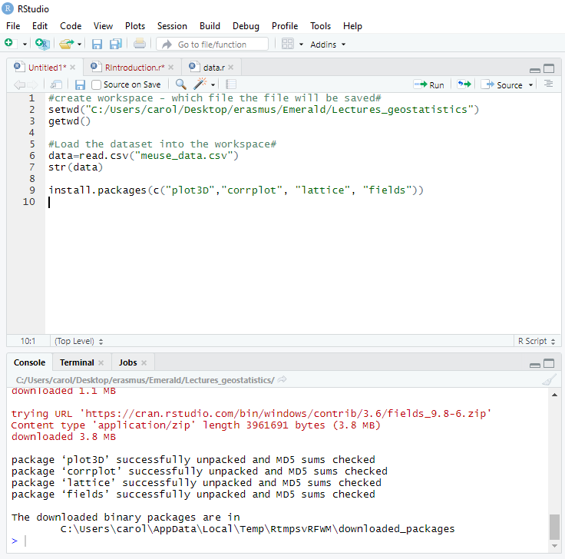
Statistics- Packages
Needs to install contributed R packages:
Use install.packages() function or Install toolbar button
Usefull packages for
descriptive statistics:
“plot3D”, “corrplot”,
“lattice”, “fields”
Geostatistics
Notes:
“plot3D” - Draws a 3D scatterplot, visualising 2-D and 3-D data.
“fields” - For curve, surface and function fitting with emphasis on spatial data, geostatistics and spatial statistics.
“lattice” - Improve the graphics by providing better defaults and the ability to easily display multivariate relationships
“corrplot” - graphical display of a correlation matrix

Slide 25
Statistics
Questions you should address:
Describe the distribution of the variable. Is it symmetric or skewed? Does it appear to come from one population? Do there appear to be any “outliers”?
What are the minimum, median, std deviation in the sample set?
Compare the mean and median. What does this imply about the distribution of the variable?
The distribution of metal concentrations usually are far from symmetrical. A common transform for a highly-skewed distribution is the logarithm.
Is the transformed variable more symmetric? What happened to the presumed outliers?
Geostatistics
Notes:
“plot3D” - Draws a 3D scatterplot, visualising 2-D and 3-D data.
“fields” - For curve, surface and function fitting with emphasis on spatial data, geostatistics and spatial statistics.
“lattice” - Improve the graphics by providing better defaults and the ability to easily display multivariate relationships
“corrplot” - graphical display of a correlation matrix

Slide 26
Bivariate EDA
plot(data$zinc ~ data$copper)
pairs(meuse[, 15:18])
Questions you should address:
Do the two variables appear to be related in feature space?
Find the observations that do not fit the general pattern of the copper vs. zinc relation

Slide 27
Geostatistics
Needs to install RGeostats package:
Install the package Rcpp: install.package(“Rcpp”)
http://rgeostats.free.fr/download.php
Install the package manually (Tools – Install packages)
Geostatistics

Slide 28
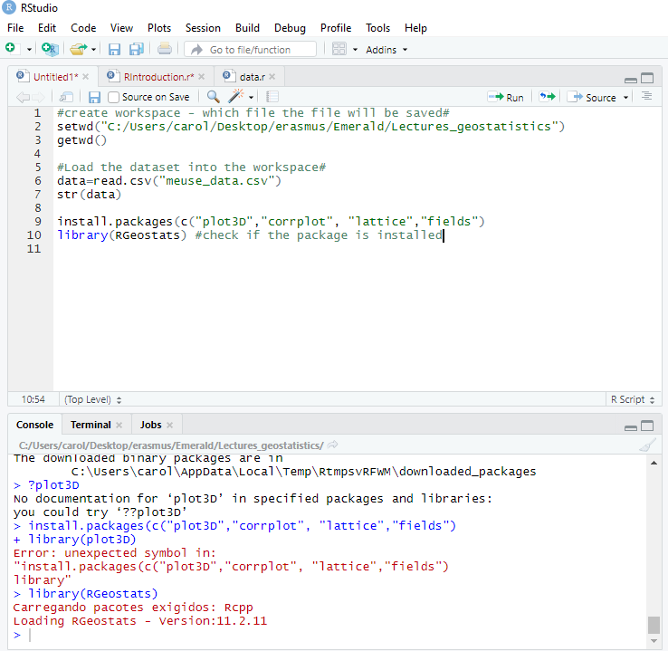
Geostatistics
Geostatistics

